Slide 1

AI-BASED CONSTRAIN SATISFACTION SOLVER FOR AUTOMATED TIMETABLE SCHEDULING
CSA1709-Artificial Intelligence
Guided by:
Dr.P.Rajaram
Presented by:
T.S.Vidhushini [192511061]
K.S.Dharshana[192412015]
G.Kaviya[192524281]

Slide 2


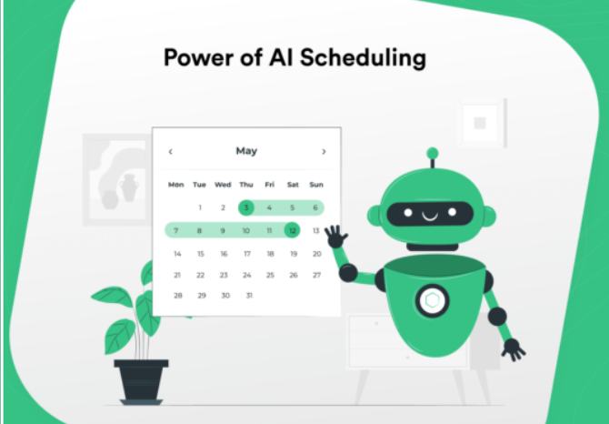
INTRODUCTION
Timetable scheduling is an important but complex task in educational institutions.
Manual timetable preparation requires considerable time and effort.
Conflicts may occur between faculty, classrooms, subjects, and time slots.
This project uses Artificial Intelligence and Constraint Satisfaction Problem (CSP) techniques to automate timetable generation.
The system aims to generate a conflict-free and optimized timetable automatically.

Slide 3
OBJECTIVES
To model timetable scheduling as a Constraint Satisfaction Problem.
To collect and manage faculty, subject, classroom, and time-slot information.
To automatically generate a conflict-free timetable.
To detect and report scheduling conflicts.
To reduce timetable generation time and manual effort.
To optimize the utilization of classrooms and faculty.
To provide an easy-to-use web-based interface for timetable generation.
Expected Outcome
A fully automated system capable of generating an optimized timetable while satisfying the defined constraints.

Slide 4

PROBLEM STATEMENT
Manual timetable preparation is time-consuming and difficult.
Faculty clashes can occur when teachers are assigned to multiple classes at the same time.
Room conflicts occur when multiple classes need the same classroom.
Class and subject overlaps can affect students’ schedules.
Changes in faculty, rooms, or time slots require repeated manual adjustments.
An AI-based system is needed to automatically create an optimized and conflict-free timetable

Slide 5
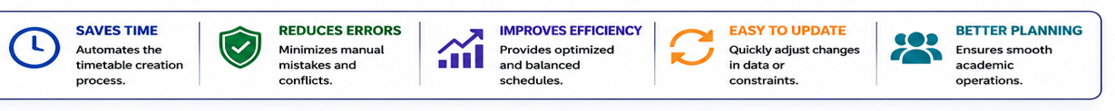
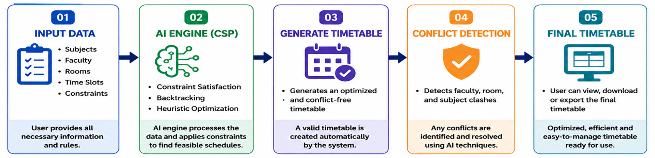
PROPOSED SOLUTION
INPUT DATA (01)
Subjects
Faculty
Rooms
Constraints
User provides all necessary information and rules.
AI ENGINE (CSP) (02)
Constraint Satisfaction
Backtracking
Heuristic Optimization
processes and applies constraints to find feasible schedules.
GENERATE TIMETABLE (03)
Generates an optimized and conflict free timetable
A valid timetable is created automatically by the system.
CONFLICT DETECTION (04)
Detects faculty, room, and subject clashes
Any conflicts are identified and resolved using AI techniques.
FINAL TIMETABLE (05)
User can view, download, or export the final timetable
Optimized, efficient, and easy-to-manage timetable ready for use.
BENEFITS

Slide 6
LITERATURE REVIEW
S.No. | Author & Year | Research Paper | Finding | Limitation
1 | Ceschia et al. (2022) | Educational Timetabling | Studied timetable problems and solutions. | Survey-based.
2 | Bashab et al. (2023) | Optimization Techniques in University Timetabling | Studied constraints and optimization. | Computational complexity.
3 | Agrawal et al. (2024) | Examination and Class Timetabling | Applied optimization to scheduling. | Problem-specific.
4 | Kiyohara & Ishihata (2024) | Constraint Programming for Course Scheduling | Generated feasible schedules using constraints. | Limited scheduling scope.
5 | Gu et al. (2025) | Integer Programming to Machine Learning for Timetabling | Explored AI and optimization methods. | Requires further development.

Slide 7
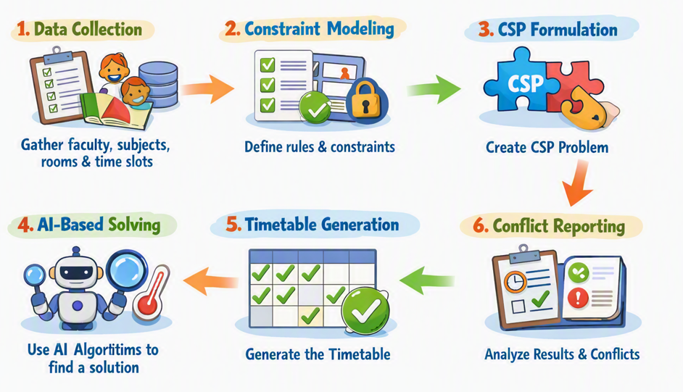
METHODOLOGY
1.Data Collection Collect faculty, subjects, classrooms, sections, and available
time slot data.
2. Constraint Modeling Define faculty, room, student, and time-slot constraints.
3. CSP Formulation Model timetable scheduling as a Constraint Satisfaction Problem (CSP).
4. AI-Based Solving Apply Backtracking Search, Local Search/Simulated Annealing,
and Heuristic Variable Ordering to find a valid solution.
5. Timetable Generation Generate an optimized timetable satisfying the defined constraints.
6. Conflict Reporting Evaluate constraint satisfaction, generation time, and conflicts resolved.

Slide 8
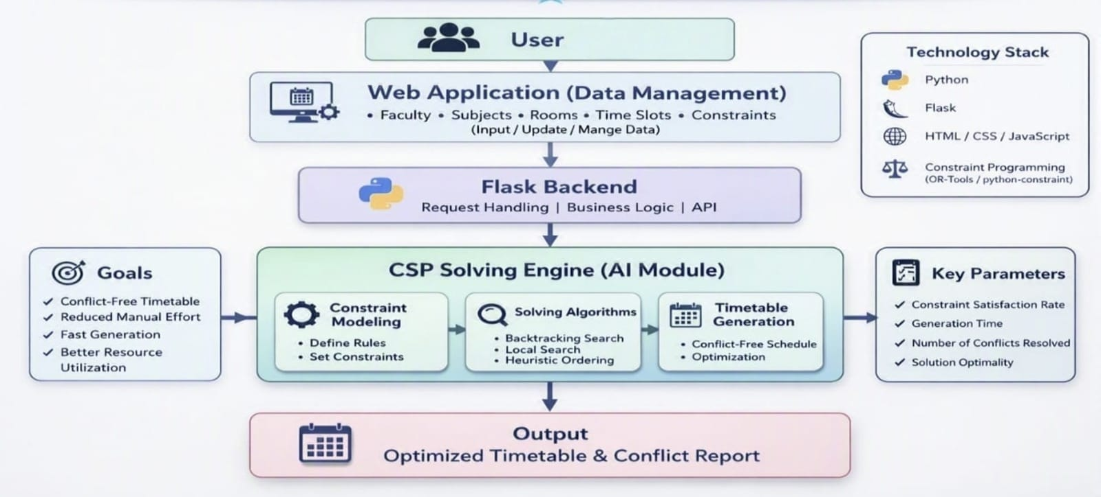
SYSTEM ARCHITECTURE

Slide 9
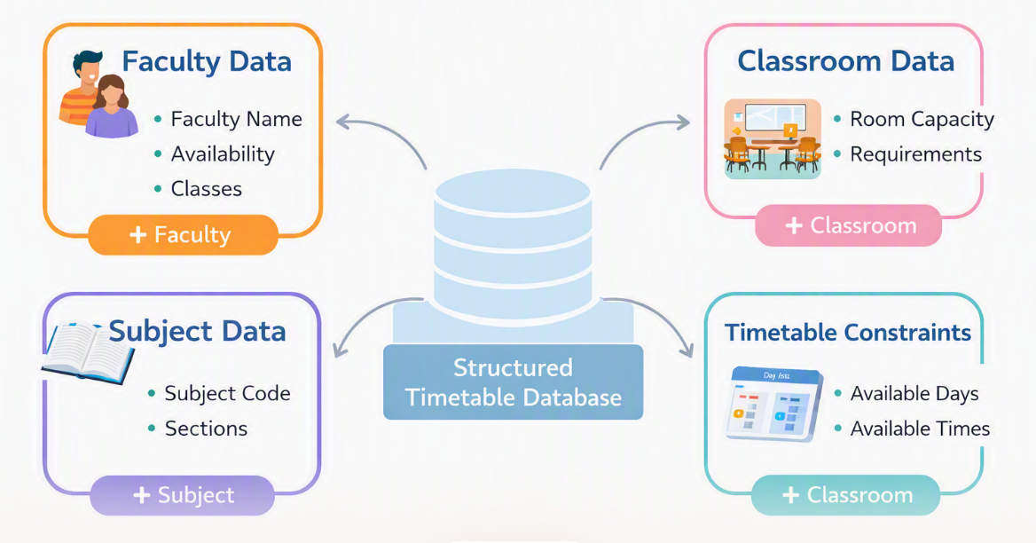
Module 1: Data Collection &Constraint Modeling
Collect all essential academic data such as faculty, subjects, classes, sections, and classrooms.
Define available working days and time slots for scheduling the timetable.
Record classroom details, including room capacity and laboratory requirements.
Specify scheduling constraints such as faculty availability, room availability, and class requirements.
Organize the collected information into structured data for accurate and efficient CSP-based timetable generation.

Slide 10
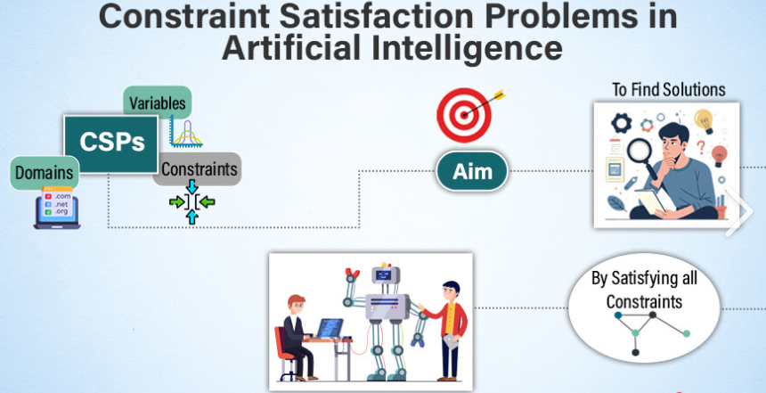
Module 2: CSP Solving Engine
Model the timetable as a Constraint Satisfaction Problem (CSP) with variables, domains, and constraints.
Assign subjects to suitable time slots, faculty, and classrooms based on the defined constraints.
Use Backtracking Search to find valid solutions and handle scheduling conflicts.
Apply heuristic techniques to select the most suitable variables and improve solving efficiency.
Optimize the generated schedule using Local Search or Simulated Annealing for better resource utilization.

Slide 11
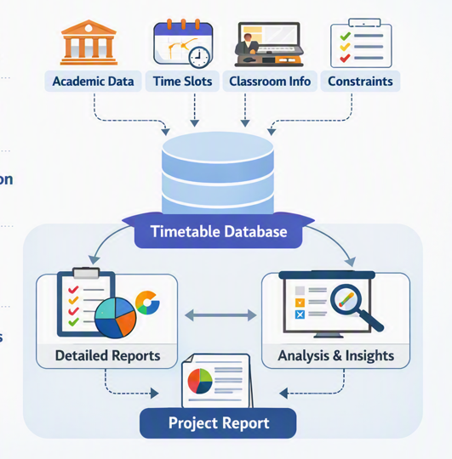
Module 3: TimetableGeneration & ConflictReporting
Generate an optimized timetable by applying all defined scheduling constraints.
Validate the timetable to ensure faculty, classroom, class, and time-slot requirements are satisfied.
Detect and report scheduling conflicts for quick identification and resolution.
Present the final timetable through a user-friendly web interface for easy access and management.
Measure timetable performance using conflict rate, generation time, constraint satisfaction, and resource utilization

Slide 12
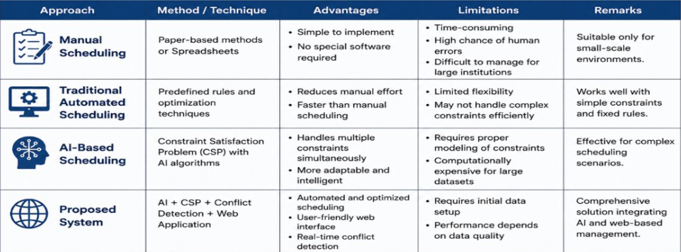
ADVANTAGES And DISADVANTAGES

Slide 13
FUTURE SCOPE
Integration with existing college management systems.
Automatic import of faculty and subject data.
AI-based preference learning.
Advanced optimization of faculty workload.
Automatic examination timetable generation.
Cloud-based deployment.
Mobile application.
Notification system for timetable changes.
Real-time timetable modification.

Slide 14
CONCLUSION
The project addresses the problem of manual and conflict-prone timetable scheduling.
Timetable generation is modeled as a Constraint Satisfaction Problem.
AI techniques such as Backtracking, Local Search, Simulated Annealing, and Heuristic Variable Ordering are used.
The proposed web application can automatically generate and display timetables.
The system aims to reduce manual effort, scheduling time, and conflicts.
The project provides a scalable foundation for intelligent timetable management.
Key Takeaway
AI can transform timetable scheduling from a manual trial-and-error process into an automated and optimized decision-making system.

Slide 15
REFERENCES
Ceschia, S., Di Gaspero, L., & Schaerf, A. (2022). Educational Timetabling: Problems, Benchmarks, and State-of-the-Art Results. European Journal of Operational Research.
Bashab, A., et al. (2023). Optimization Techniques in University Timetabling Problem: Constraints, Methodologies, Benchmarks, and Open Issues. Computers, Materials & Continua, 74(3), 6461–6484.
Agrawal, A. K., Yadav, S., Gupta, A. A., & Pandey, S. (2024). Examination and Class Timetabling Problem: A Case Study of an Indian University. International Journal of Operational Research, 50(3), 291–315.
Kiyohara, M., & Ishihata, M. (2024). A Constraint Programming Approach to Fair High School Course Scheduling.
From Integer Programming to Machine Learning: A Technical Review on Solving University Timetabling Problems. (2025). Computation, 13(1), 10.
Maspiyanti, F., Gatc, J., Nursari, S. R. C., & Murtako, A. (2025). Course Timetabling Using Genetic Algorithm and Fuzzy Cross-Over. JOIV: International Journal on Informatics Visualization, 9(5), 2133–2141.

Slide 16


